Slide 1
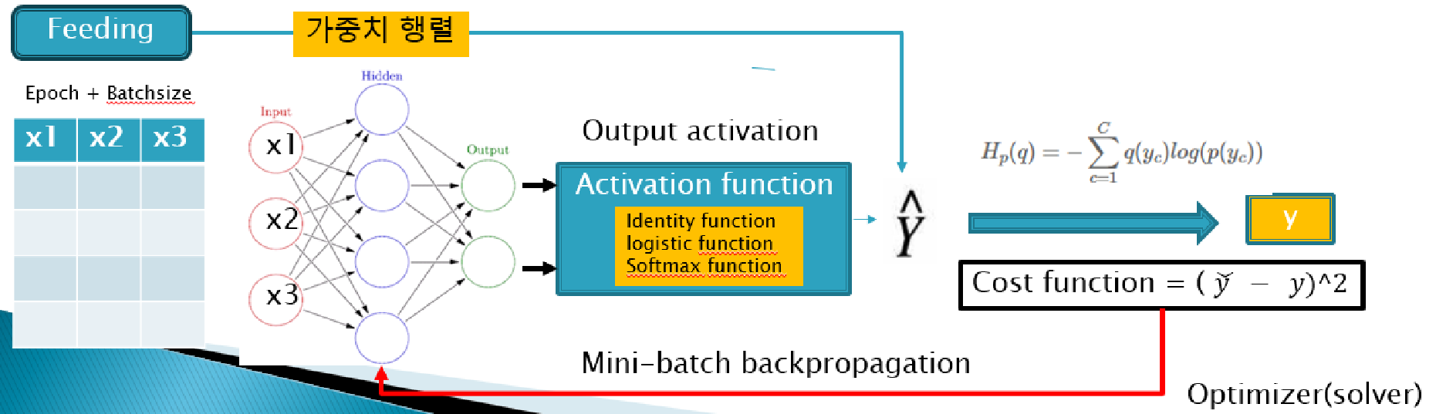
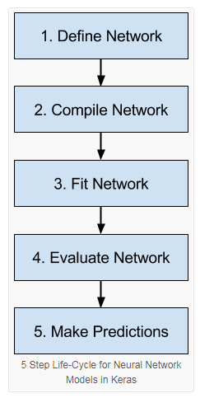
Tensorflow 2.x 구조 ( 2025)
Keras Model 구조
Model
Input object
Dense layer
Activation layer
Lambda layer
Identity layer
sequential
functionals
model.summary()
Tensorflow 코드
(loss, optimizer, metrics)
Loss, accuracy
History
kerasClassfier가 fit함수의 역할
- epochs, batch_size를 튜닝
Loss
accuracy
Keras wrapper
Keras model
ModelCheckpoint
BackupAndRestore
TensorBoard
EarlyStopping
LearningRateScheduler
함수화
pipeline
1. Fit파라미터 튜닝
2. Compile에 파라미터 전달
3. 파이프라인 파라미터 전달
Callback(hook)
Scikits : GridSearchCV( )

